Slide 1
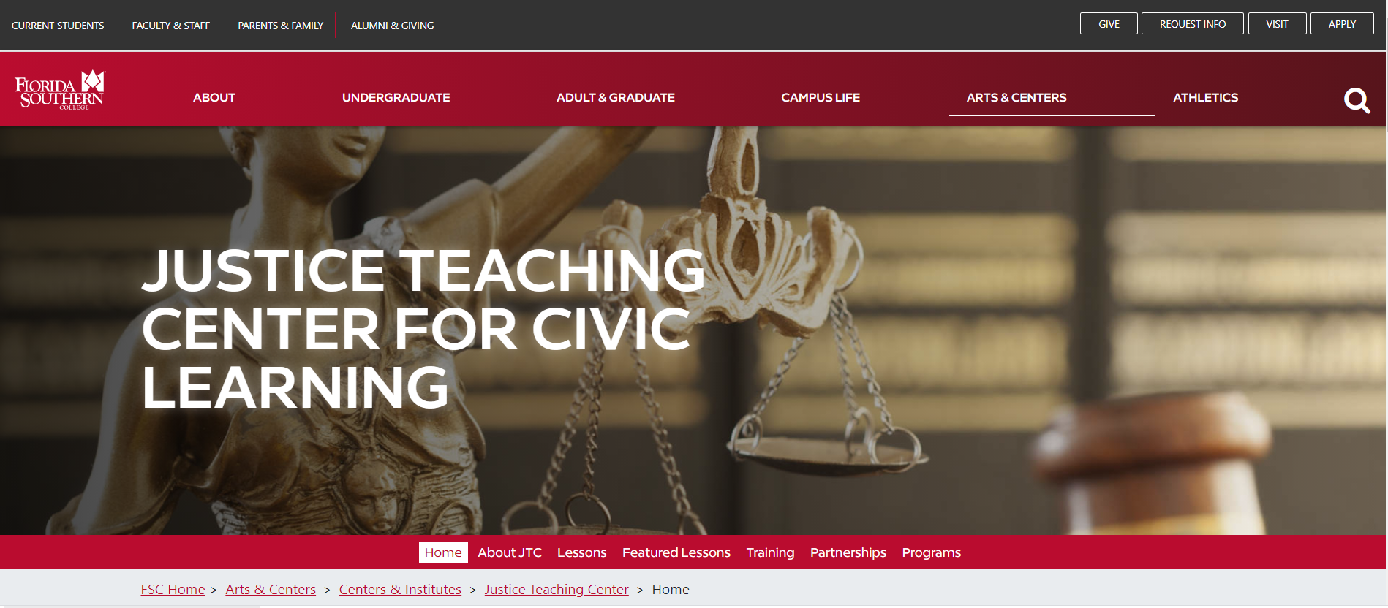
Justice Teaching Center at Florida Southern College
Notes:
Highlight Florida Southern location and website.

Slide 2

Our Goal:
State and national surveys frequently document how little Americans know about our government, the justice system, and the basic principles underlying our constitutional institutions and design.
We want to change that!

Slide 3
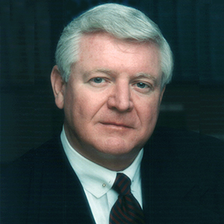
What is Justice Teaching?
Flagship program created by Justice R. Fred Lewis (Ret.).
Partners judges and attorneys as trained resource persons with schools to support teachers and classroom instruction.
Resource materials aligned with state standards in civics and government.
New infrastructure and experiential programs and resources for students of all ages.
Professional development and training opportunities to expand civic knowledge and skills.
Justice R. Fred Lewis
EMINENT PROFESSOR OF LAW AND LETTERS,
JUSTICE SUPREME COURT OF FLORIDA (RETIRED)

Slide 4
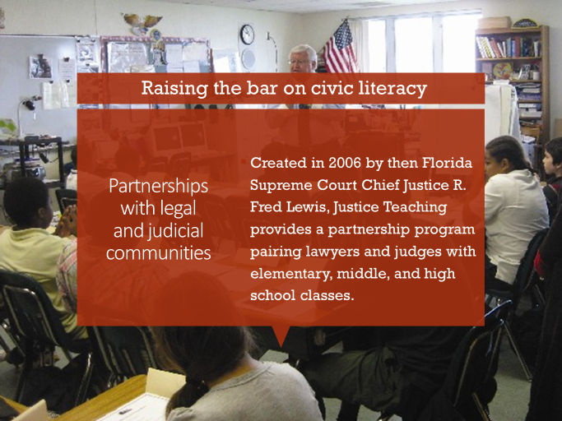
Notes:
Emphasize year created and highlight Justice Lewis

Slide 5
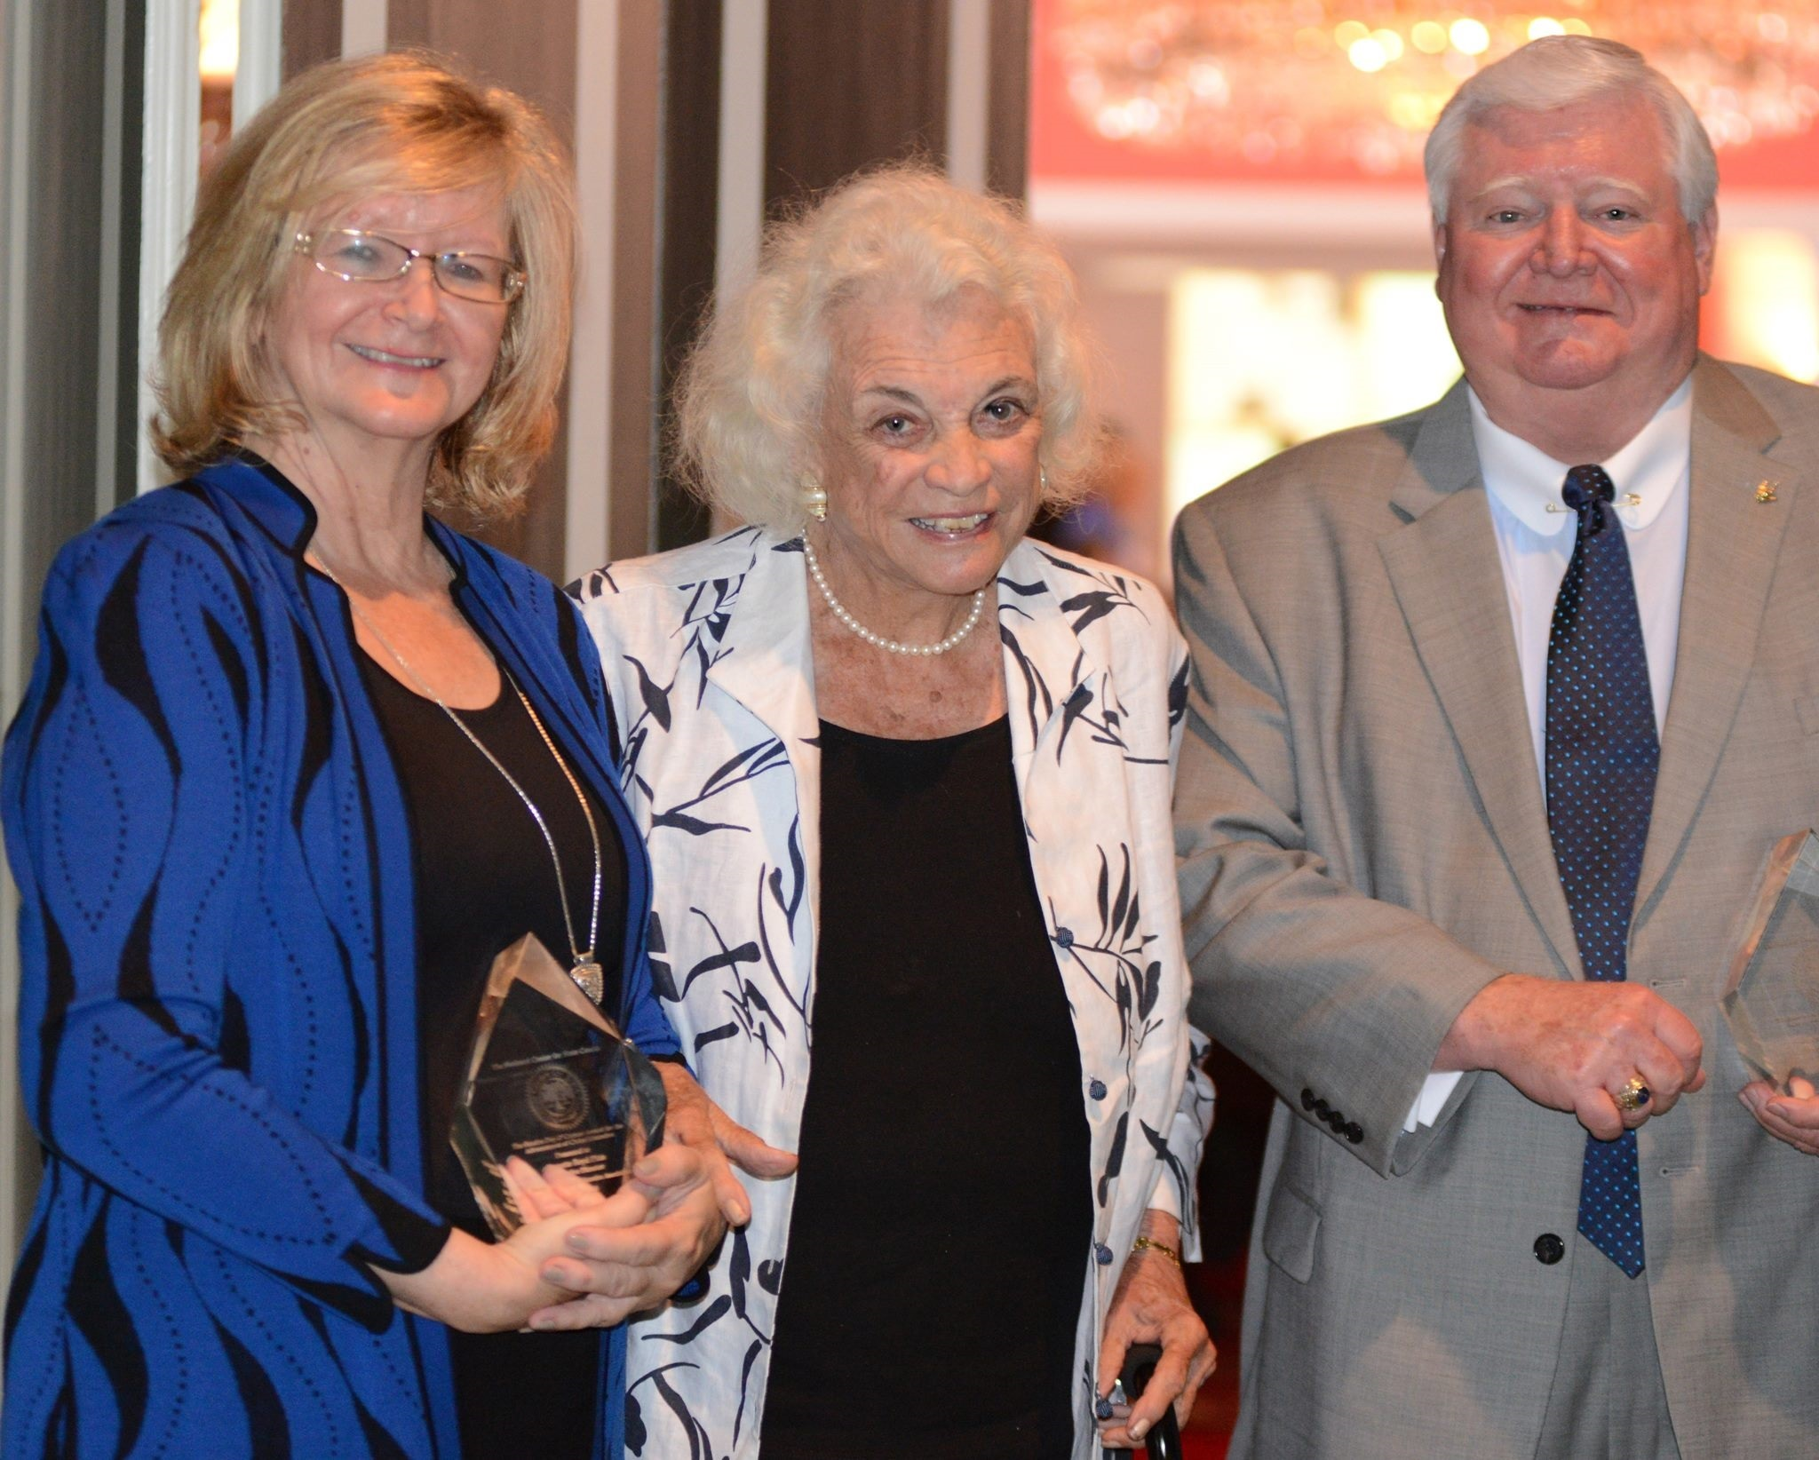
Nationally Recognized Model:
Sandra Day O’Connor National Advancements in Civics Award
Notes:
Justice Teaching leaders were recognized by the National Center for State Courts with the Sandra Day O’Connor National Advancements in Civics Award. The award was presented by retired US Supreme Court Justice Sandra Day O’Connor.

Slide 6
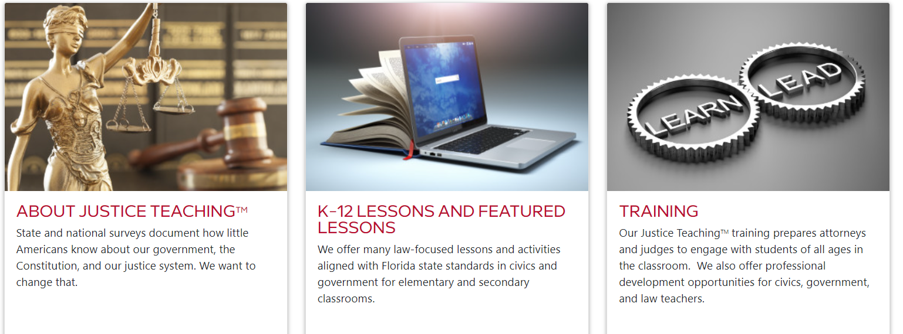
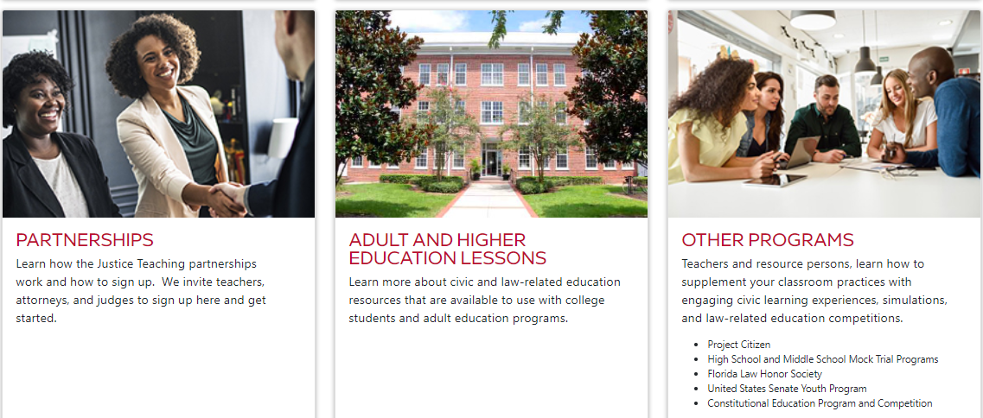
Website Resources
Visit us here to learn more!

Slide 7
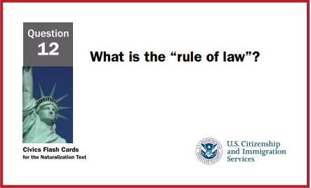
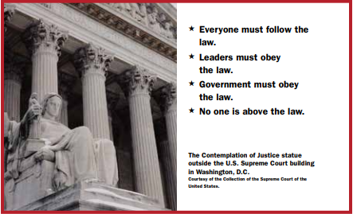
Classroom Materials
Many civics, government, and law resources are aligned with the state standards in civics and government.
New state standards in civics and government in 2023
Nonpartisan, engaging and experiential materials and training.

Slide 8
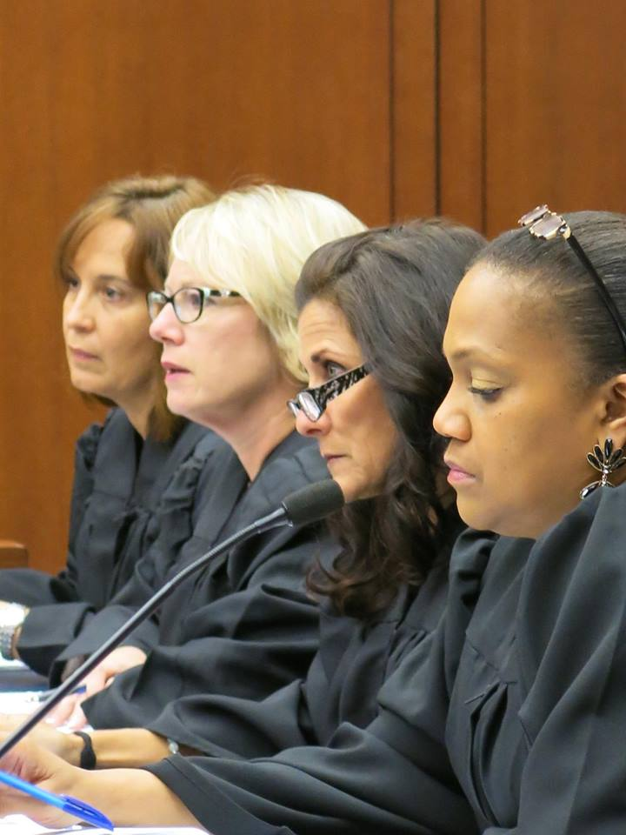
Training and Professional Development
Host professional development experiences for teachers
Partnership training for attorneys and judges
Voluntary bar training
Case study approach and other civics, government, and law resources
Simulate trials or appellate hearings as culminating events
Notes:
Annette

Slide 9
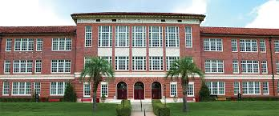

Who Needs Civics?
The Public
Schools
Notes:
Rowe

Slide 10
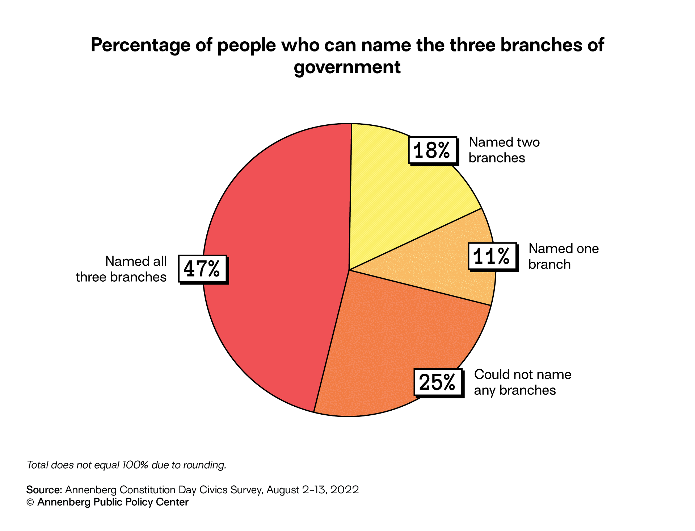
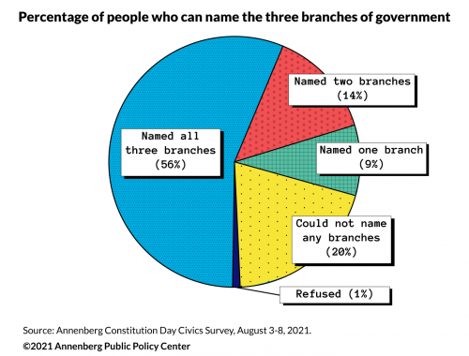
Constitution Day Survey 2022 Data
Annenberg Public Policy Center of the University of Pennsylvania
Notes:
2022 47% of people could name the three branches of government. 25% could not name any of the three branches.
In 2021, 56% of Americans surveyed correctly named the three branches of government. This is the highest percentage since the survey began in 2006.
Americans’ Civics Knowledge Drops on First Amendment and Branches of Government | The Annenberg Public Policy Center of the University of Pennsylvania
However, 20% of respondents could not name any of the three branches of government this year. The survey is conducted annually by the Annenberg Public Policy Center at the University of Pennsylvania.

Slide 11
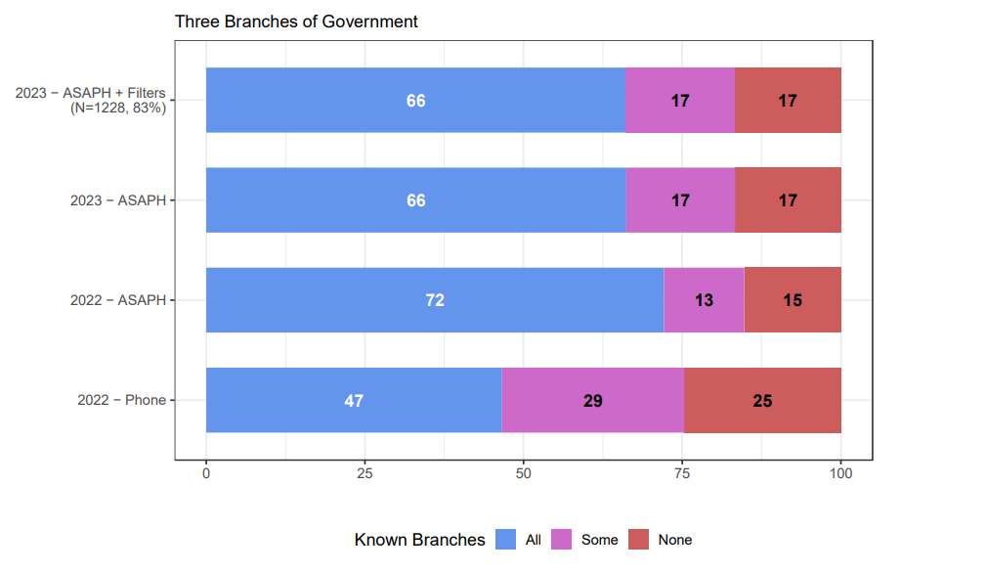
Knowledge of the 3 Branches 2023

Slide 12
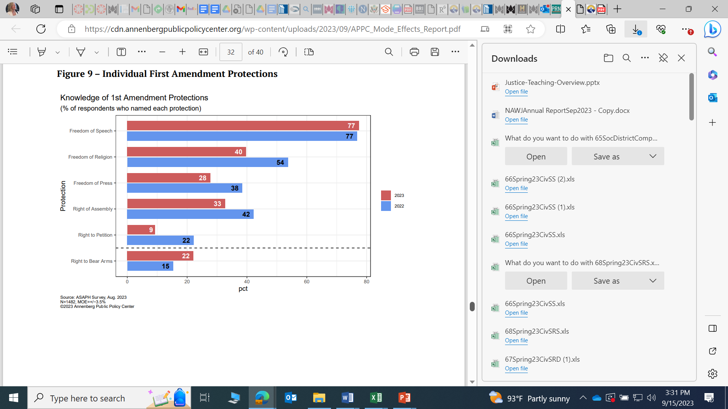
Knowledge of First Amendment 2023
Notes:
2023

Slide 13
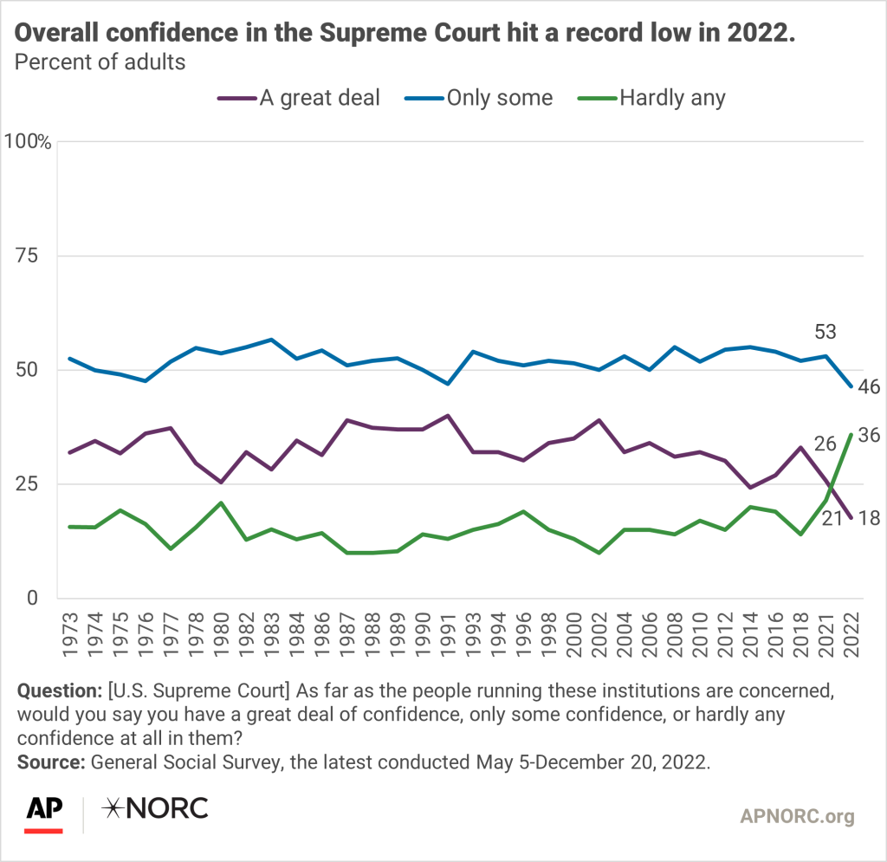
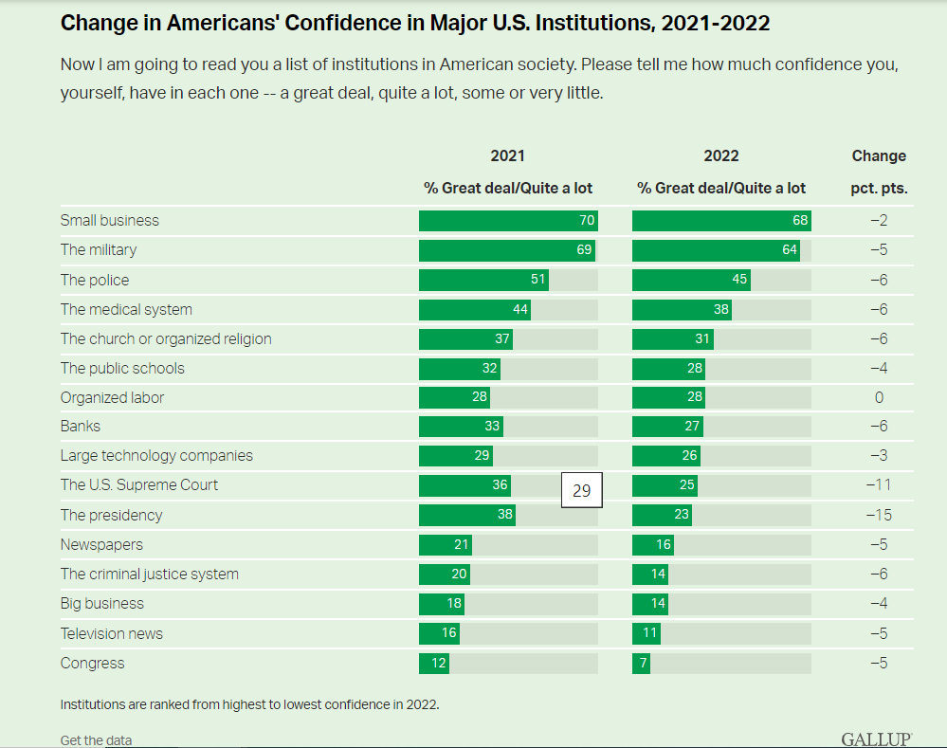
Public Confidence in Institutions
Notes:
Public confidence in the U.S. Supreme Court is at its lowest since 1973 - AP-NORC (apnorc.org)
Confidence in U.S. Institutions Down; Average at New Low (gallup.com)
Public Confidence in Institutions

Slide 14
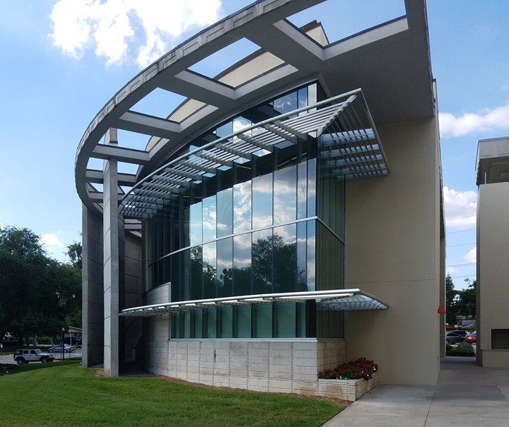
Come Join Us!
The Justice Teaching Center for Civic Learning inculcates the mission and goals of Florida Southern College to prepare students to make a positive and consequential impact on society through engaged, law-focused, civic learning opportunities.
Come join us in our work.

Slide 15
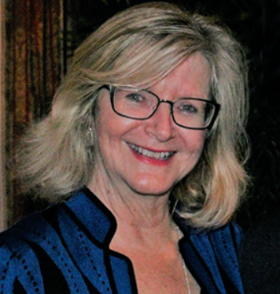
Contact:
Annette Boyd Pitts at
apitts@flsouthern.edu to schedule training, secure partnerships, and learn more about our programs and resources.
We would be honored to work with you!

